Slide 1
Project 2- Gender Statistics
Aston Rosenmeier
Lukas Fuller
Haris Dar

Slide 2
Presentation Overview
For every business question:
Assumptions
Relevant Indicator Codes
Analysis Process (MapReduce or Hive)
Results
Testing (for MapReduce)

Slide 3
Business Question 1
Find the countries where female graduation percentage is less than 30 percent.
Notes:
Data collected by:
United Nations Educational, Scientific, and Cultural Organization (UNESCO) Institute for Statistics.

Slide 4
Assumptions
Graduation rate refers to Bachelor’s degree as the minimum degree attained
We will use the most recently available statistic for each country in our analysis
We exclude post-secondary statistics because post-secondary includes trade school/associate degrees

Slide 5
Relevant Indicator Codes
SE.TER.CUAT.BA
Educational attainment, at least Bachelor's or equivalent, population 25+, female (%) (cumulative)
SE.TER.HIAT.BA.FE.ZS
SE.TER.HIAT.MS.FE.ZS
SE.TER.HIAT.DO.FE.ZS
These statistics refer to the highest attained level of education (Bachelor’s, Master’s, Doctorate)

Slide 6
MapReduce
Map
Gender_StatsData.csv is read and mapper code will not do anything until the first country in the dataset appears, which is Afghanistan.
Search for the relevant indicator codes within each country and use context.write to output the country name, the most recent statistic available for the relevant indicator code, and the year from which the statistic is being pulled from.

Slide 7
MapReduce (cont.)
Reduce
For every country that passes through the reducer, we check if the CUAT stat is available for that country first. If the statistic is available, we will use this statistic to determine if the country has a female graduation rate under 30%.
If the CUAT stat is not available, we check if all three HIAT stats are present for that country, and if so we will add those three statistics together and use that to determine if the country has a female graduation rate under 30%.

Slide 8
MapReduce (cont.)
Reduce (cont.)
We filter out our results and have the reducer only output the countries that have a female graduation rate under 30%.
Also, if the country did not provide a CUAT statistic and also they did not provide all three HIAT statistics, then we output a message saying that this country does not provide sufficient data for this statistic.

Slide 9
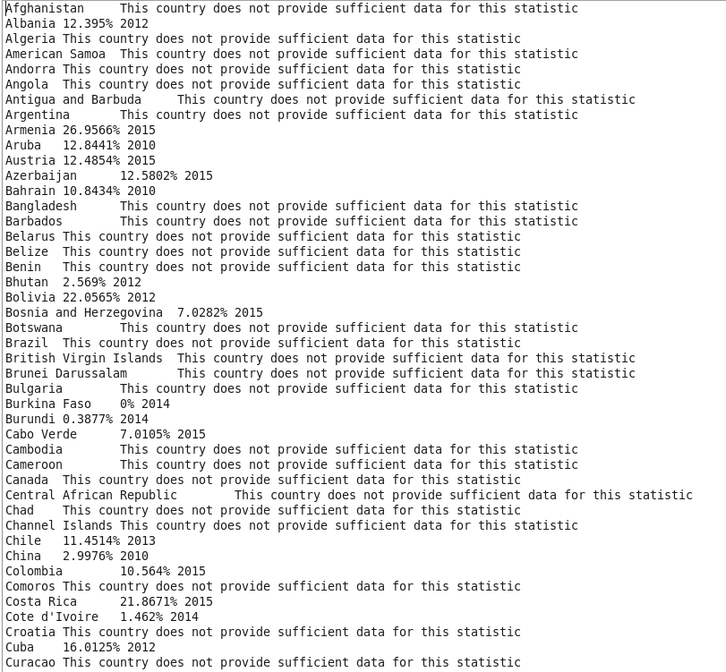
MapReduce Output for Business Question 1

Slide 10
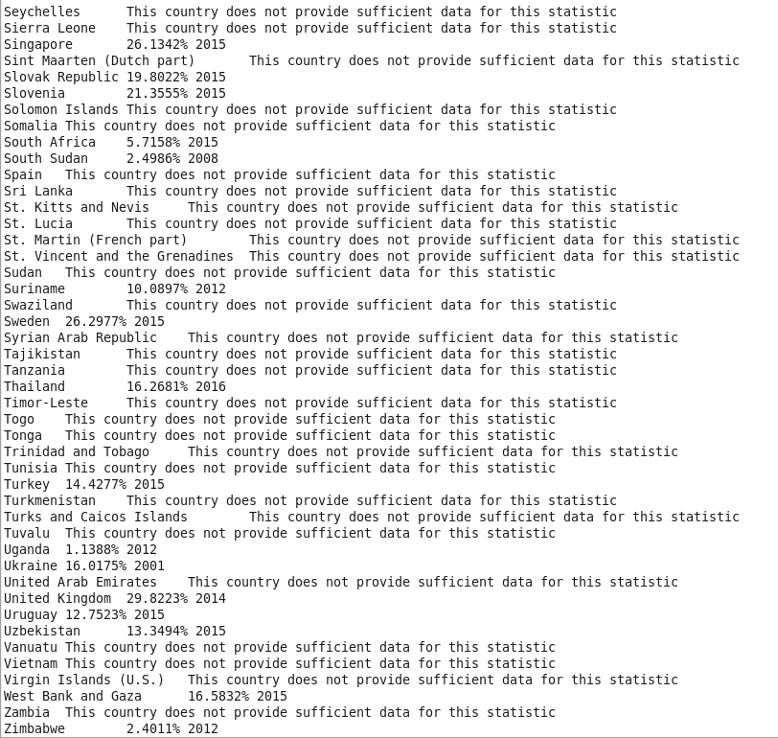
MapReduce Output (cont.) for Business Question 1

Slide 11
MRUnit
Map Test
We created a test input for the mapper by making the country name Afghanistan and copying the information for the SE.TER.CUAT.BA.FE.ZS indicator code. We put a fake statistic of 23.401 in the year 2016 index.
The test output should be “Afghanistan” for the key and “23.401 CUAT 2016” as the value, and our test succeeded

Slide 12
MRUnit (cont.)
Reduce Test
The test input we used was the test output for the map test.
The test output we created was “Afghanistan” as the key and “23.401% 2016” as the value, and this succeeded.
MapReduce Test
We used the mock input that we used for the map test and we used the mock output from the reduce test to test the combination of MapReduce, and our test ran successfully.

Slide 13
Business Question 2
List the average increase in female education in the U.S since the year 2000.
Notes:
Data collected by:
United Nations Educational, Scientific, and Cultural Organization (UNESCO) Institute for Statistics.

Slide 14
Assumptions
If the year 2000 statistic is unavailable, we will use the statistic available for the year closest to 2000.
We quantify average increase by calculating the percent change between the latest year statistic and the initial year statistic, and then dividing that percent change by the amount of years that have spanned.
Calculate average increase in education for primary, secondary, and tertiary education levels, and then find an overall average increase across all education levels

Slide 15
Relevant Indicator Codes
SE.PRM.CUAT.FE.ZS
Educational attainment, at least primary school
SE.SEC.CUAT.LO.FE.ZS
Educational attainment, at least lower secondary (middle school)
SE.SEC.CUAT.UP.FE.ZS
Educational attainment, at upper secondary (high school)
SE.TER.CUAT.ST.FE.ZS
Educational attainment, at least short-cycle tertiary (any degree past high school)

Slide 16
Hive Queries
Query to create table that holds the entire Gender_StatsData.csv file
CREATE TABLE GENDER_STATS (COUNTRY_NAME STRING, COUNTRY_CODE STRING, INDICATOR_NAME STRING, INDICATOR_CODE STRING, YEAR_1960 DECIMAL, YEAR_1961 DECIMAL,… YEAR_2015 DECIMAL, YEAR_2016 DECIMAL) ROW FORMAT SERDE 'org.apache.hadoop.hive.serde2.OpenCSVSerde' with serdeproperties ( "separatorChar" = ",") TBLPROPERTIES("skip.header.line.count"="1");

Slide 17
Hive Queries (cont.)
To create a view which only displays the statistics of interest for the United States:
CREATE VIEW US_FEMALE_EDUCATION( column name information (same as Gender_Stats))AS SELECT * FROM GENDER_STATSWHERE COUNTRY_NAME=’United States’ AND (INDICATOR_CODE='SE.PRM.CUAT.FE.ZS' OR INDICATOR_CODE ='SE.SEC.CUAT.LO.FE.ZS' OR INDICATOR_CODE='SE.SEC.CUAT.UP.FE.ZS'OR INDICATOR_CODE='SE.TER.CUAT.ST.FE.ZS');

Slide 18
Hive Queries (cont.)
Query to create a table which displays the average yearly percent change in female education for primary, secondary, and tertiary education levels
CREATE TABLE US_Yearly_Avg_Percent_3 AS SELECT Country_Name,Indicator_Name,Year_2004,Year_2015,(((Year_2015-Year_2004)/Year_2004)/11)*100 AS avg_percentchange_yeartoyear FROM US_Female_Education;

Slide 19
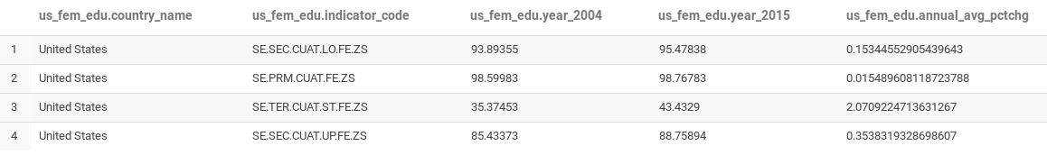
Query Output

Slide 20
Hive Queries (cont.)
Query to calculating average yearly increase in female education across all levels of education
CREATE TABLE US_Overall_Female_Education AS SELECT Country_name, sum(avg_percent_change_yeartoyear)/4 AS US_yearly_avg_percent FROM US_Yearly_Avg_Percent GROUP BY Country_name;

Slide 21
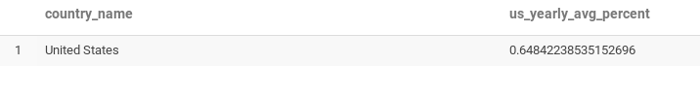
Query Output

Slide 22
Business Question 3
List the percent change in male employment from the year 2000.
Notes:
Data collected by International Labor Organization, ILOSTAT Database, retrieved in March 2017.

Slide 23
Assumptions
Percent change will be calculated using standard percent change formula
The business question is asking for the individual percent change in male employment for every country.
Use the “World” country name and the associated statistics to get a percent change value for the change in male employment for the entire world.

Slide 24
Relevant Indicator Codes
SL.EMP.TOTL.SP.MA.ZS
Employment to population ratio, 15+, male (%) (modeled ILO estimate)
We choose to use the data provided by the International Labor Organization in favor of the national estimate data due to the fact that more countries provided ILO estimate data for male employment compared to national estimate data.

Slide 25
MapReduce
Map
We determined that the year 2000 statistic is located at index 46 for this particular indicator code.
We check to see if the country has a year 2000 statistic and store it in a variable, and if year 2000 is unavailable, we store the statistic for the year closest to 2000 for that country.
Through further analysis, we noticed that if a country provides ILO estimate data for male employment, then a year 2000 statistic will be available for that country

Slide 26
MapReduce (cont.)
Map (cont.)
We store the latest statistic available for each country in another variable
Through further analysis, we noted that every country that provides an ILO estimate for male employment will have the latest statistic available in the year 2015.

Slide 27
MapReduce (cont.)
Map (cont.)
We output every country in the mapping phase, but if the appropriate data is not available we print a message saying “No Data Available” for that country.
If the country does have the appropriate data, we output the country name as the key and both year 2000 and the year 2015 statistic as the value.

Slide 28
MapReduce (cont.)
Reduce
We iterate through the Text Iterable that holds the statistical information for each country
First we check to see if the country has the relevant statistics, and if they do, we create an array to hold the individual values for the year 2000 statistic and the year 2015 statistic.

Slide 29
MapReduce (cont.)
Reduce
We cast these values into doubles so we can do the percent change calculation using these two values.
We output the country name with the percent change statistic if the country has the statistics available, and if the country does not have the data we output the message “No Data Available.”

Slide 30
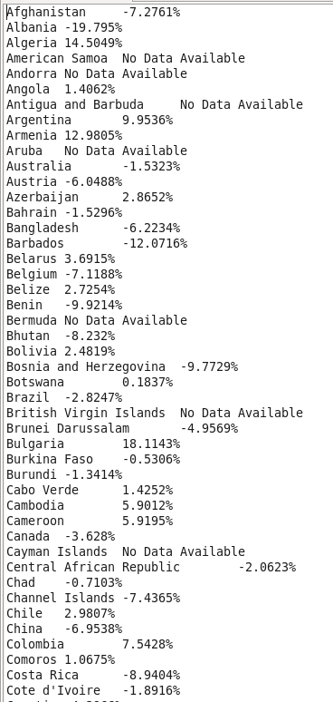
MapReduce Output for Business Question 3

Slide 31
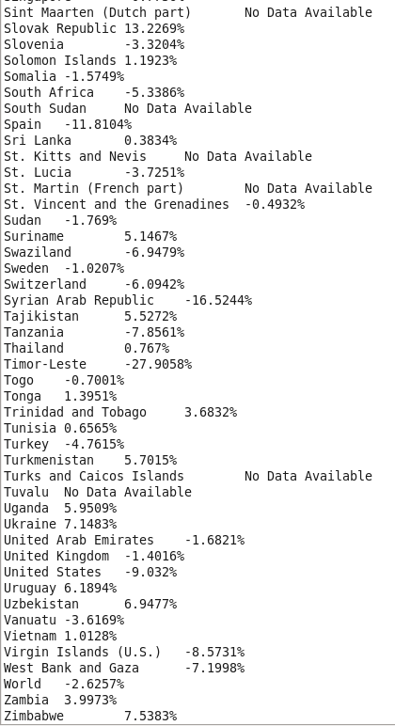
MapReduce Output (cont.) for Business Question 3

Slide 32
MRUnit
Map Test
We created a test input which consisted of the country name being “World,” the indicator code being “SL.EMP.TOTL.SP.MA.ZS”.” We populated the statistics with random statistics but kept the year 2000 statistic and the yar 2015 statistic the same as the original data.
We set our map test outpt to be “World” as the key and both the year 2000 statistic and the year 2015 statistic as the value, and our test ran successfuly.

Slide 33
MRUnit (cont.)
Reduce Test
The reduce test input is the same as the test output for the map test.
The test output is “World” as the key and the percent change as the value which is “-2.6257%”. Our test ran successfully.
MapReduce Test
We used the test input for the mapper and the test output for the reducer, and our test ran successfully.

Slide 34
Business Question 4
List the percent change in female employment from the year 2000.
Notes:
Data collected by International Labor Organization, ILOSTAT database, retrieved in March 2017.

Slide 35
Assumptions
The business question is asking for the individual percent change in female employment for every country
Include the “World” country name for a total estimate

Slide 36
Relevant Indicator Codes
SL.EMP.TOTL.SP.FE.ZS
Employment to population ratio, 15+, female (%) (modeled ILO estimate)
We chose this indicator code because the statistic is more widely available compared to the national estimate for female employment

Slide 37
Hive Queries
Query to isolate the indicator code for the statistic showing female employment (ILO estimate)
Create TABLE female_employment
AS
select * from gender_stats
where indicator_code='SL.EMP.TOTL.SP.FE.ZS';

Slide 38
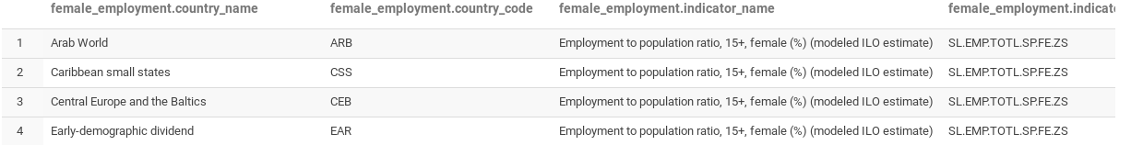
Output

Slide 39
Hive Queries (cont.)
Creates table excluding the unnecessary regions (reverse alphabet)
Create table female_employment_2
AS
select * from
(select *,ROW_NUMBER() over (order by indicator_code) as rowid from female_employment)t where rowid between 0 and 218;

Slide 40
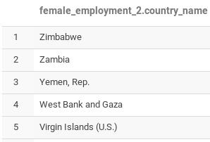
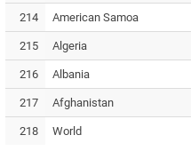
Output

Slide 41
Hive Queries (cont.)
Reverses the order to alphabetical
create table female_employment_3
AS
select * from female_employment_2
order by country_name;
drop table female_employment_2;

Slide 42
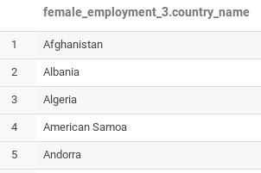
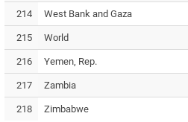
Output

Slide 43
Hive Queries (cont.)
Query to display percent change for female employment for every country and the world
Create Table us_female_employment AS select country_name, year_2000, year_2016, ((year_2016-year_2000)/year_2000)*100 AS percent_change from female_employment_3;

Slide 44
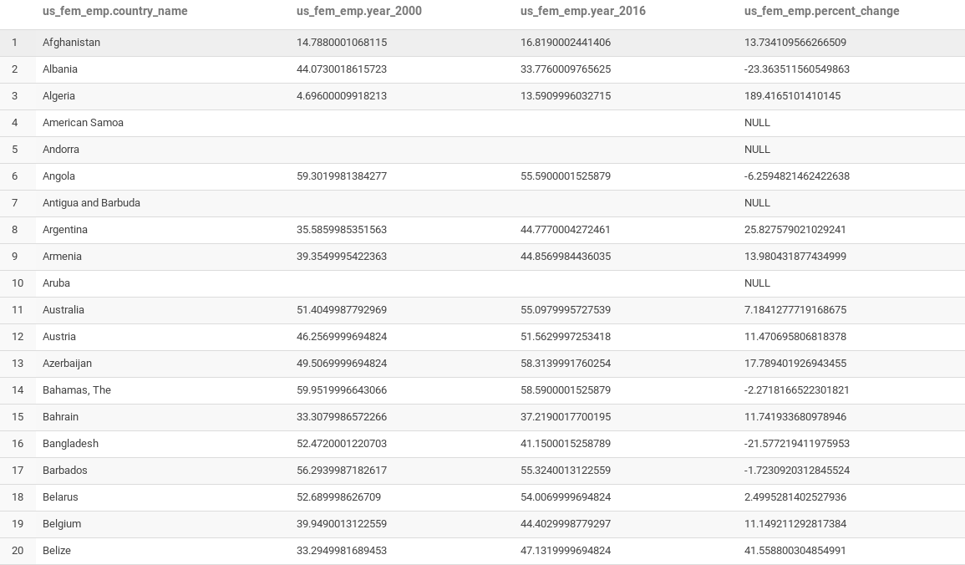

Slide 45
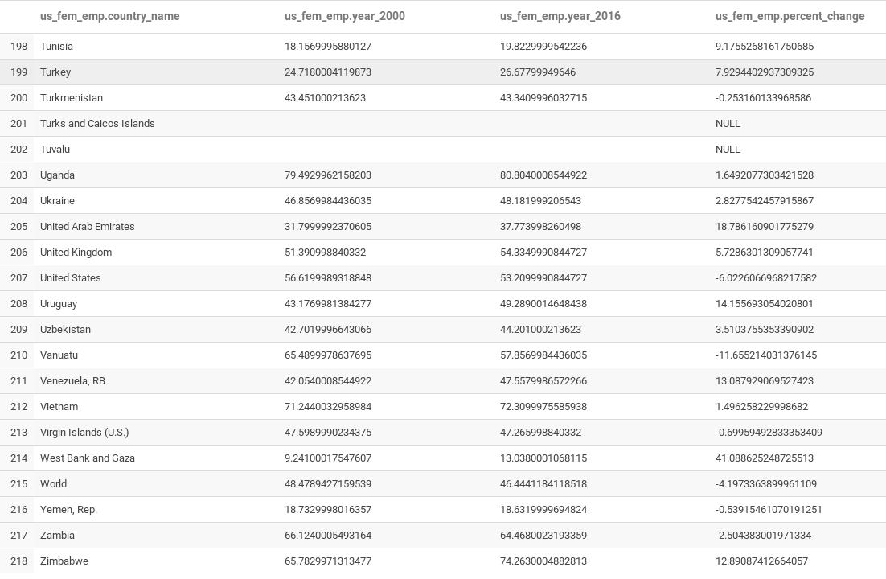

Slide 46
Business Question 5
List the percent difference in countries from 1960 to 2015 in adolescent fertility rate.
Notes:
This data was collected by the United Nations Population Division, World Population Prospects.

Slide 47
Assumptions
Percent value for this statistic is determined by dividing the value of the statistic by 1000 (births per 1000) and then multiplying that value by 100 to obtain a percentage.
Percent difference is calculated by subtracting the percent value for 2015 from the percent value for 1960.

Slide 48
Relevant Indicator Codes
SP.ADO.TFRT
Adolescent fertility rate (births per 1000 women ages 15-19)

Slide 49
Oozie Direct Acyclic Graph
Start
Sqoop Export
If OK
Sqoop Import
If OK
Hive
If OK
End
If ERROR
If ERROR
If ERROR
Kill

Slide 50
Sqoop Export
sqoop export --connect jdbc:mysql://localhost/GENDERSTATS_DB --username STUDENT_ADMIN --password p4ssw0rd --table ADOLESCENT_FERTILITY_RATE --input-enclosed-by '"' --fields-terminated-by ',' --lines-terminated-by '\n' --export-dir Project2/Downloads/Gender_StatsData.csv -m 1

Slide 51
Sqoop Import
sqoop import --connect jdbc:mysql://localhost/GENDERSTATS_DB --username STUDENT_ADMIN --password p4ssw0rd --table ADOLESCENT_FERTILITY_RATE --hive-overwrite -m 1

Slide 52
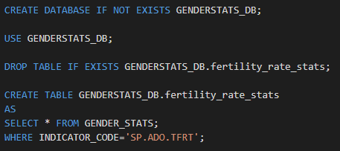
Hive Queries

Slide 53
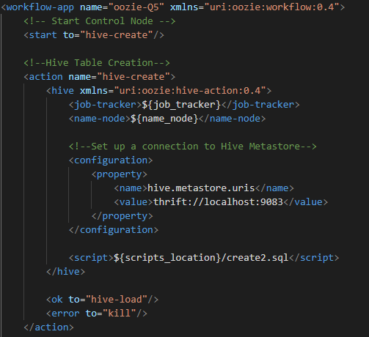
Workflow.xml for Hive actions

Slide 54
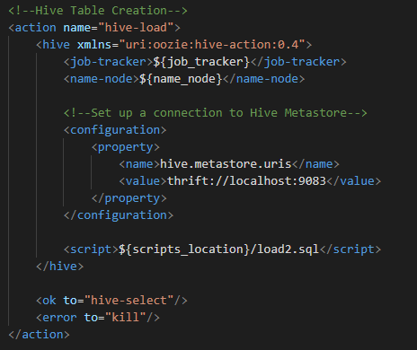
Workflow.xml (cont.) for Hive actions

Slide 55
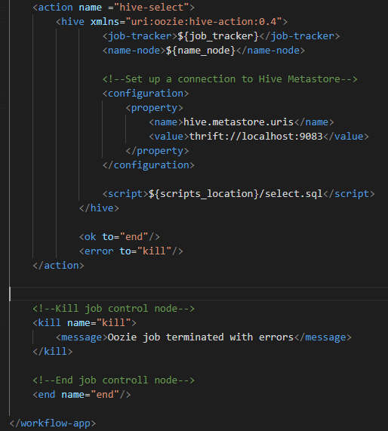
Workflow.xml (cont.) for Hive actions

Slide 56
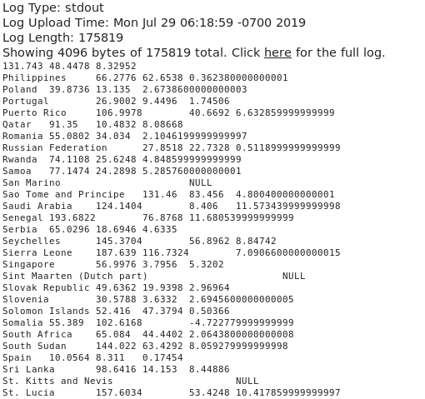
Std. out of Oozie Job

Slide 57
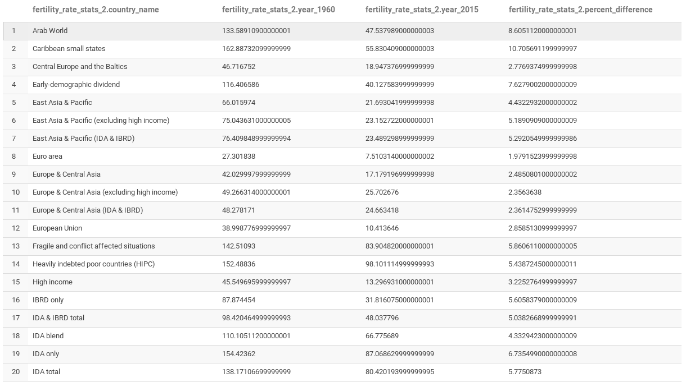

Slide 58
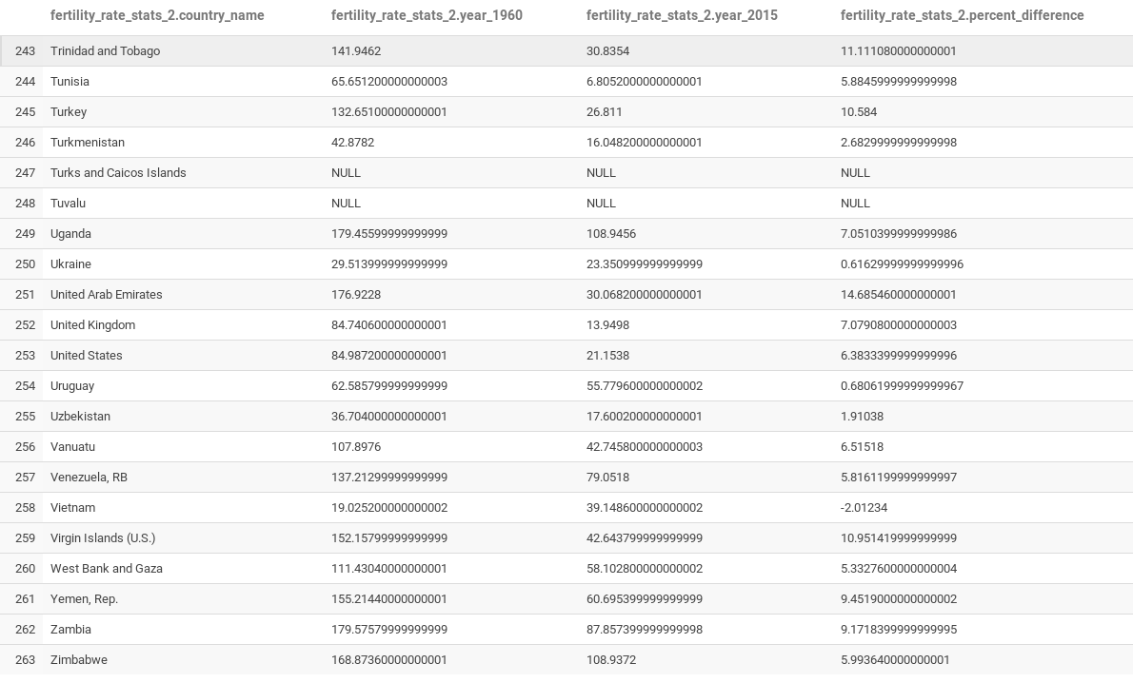

Slide 59
Questions?

